Slide 1
DATA ANALYST
Internship Task Presentation
By: Aditya Kumar Sharma
ShadowFox Internship | August Batch 1

Slide 2
OVERVIEW
Contents
01
Acknowledgement
02
Beginner Level — Retail Sales Dashboard
03
Intermediate Level — Customer & Revenue Analysis
04
Advanced Level — Power BI Attrition Dashboard
05
Conclusion

Slide 3
SECTION 01
Acknowledgement
I would like to express my gratitude to ShadowFox for giving me the opportunity to work on real-world, progressively challenging data analysis tasks during this internship.
I would also like to extend my thanks to my mentor, Mr. Aakash, for guidance and feedback throughout this experience.
All tasks were completed independently by me. Public datasets (Kaggle) were used for analysis, and Claude (Anthropic) was used as an assistant for research, troubleshooting, and reference guidance throughout the process.

Slide 4
SECTION 02
Beginner Level
Retail Sales Dashboard — Excel
Task: Analyze a retail sales dataset (Superstore, ~9,800 orders) and build a spreadsheet-based KPI dashboard.
Cleaned raw data — handled date formatting, verified no duplicates or missing critical values.
Calculated key metrics: Total Sales, Total Orders, Average Order Value.
Built category-wise, region-wise, and monthly trend analysis with charts.
Consolidated everything into a single-page dashboard with KPI cards.
KEY FINDING
Clear seasonal spike every September–November, with steady year-over-year growth from 2015 to 2018.
Tools: Microsoft Excel • SUMIF / SUMIFS / COUNTIFS
Dataset: Kaggle — Superstore Sales

Slide 5
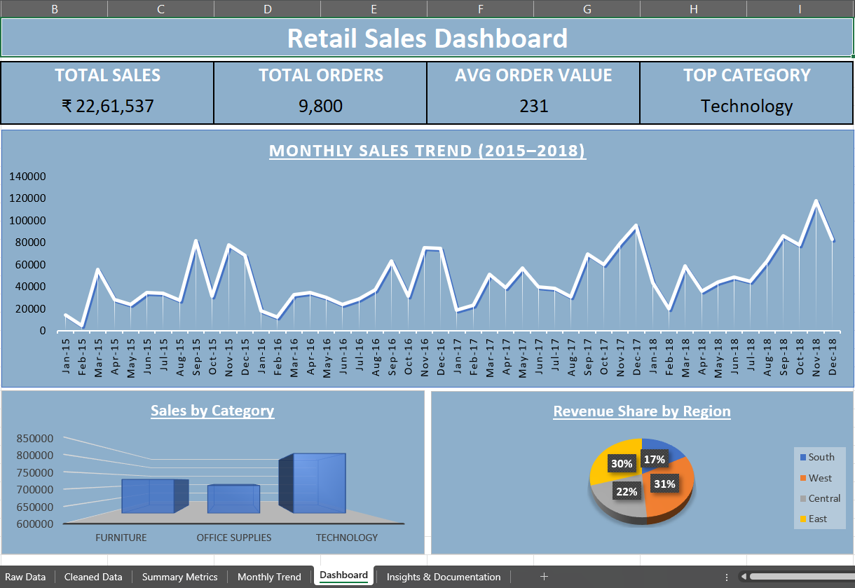
Beginner Level — Final Dashboard

Slide 6
SECTION 03
Intermediate Level
Customer & Revenue Analysis — Excel
Task: Move beyond summary reporting into customer behavior, segment performance, and revenue concentration.
Customer analysis: 793 unique customers; top 10 customers = only 6.8% of revenue.
Segment analysis: Consumer segment alone drives 50.8% of total revenue.
Product analysis: 8 of 17 sub-categories generate 78% of total revenue.
KEY FINDING
Revenue is well-diversified across customers (low concentration risk), but heavily reliant on the Consumer segment and a handful of top-performing sub-categories.
Findings converted into 6 data-backed business recommendations.
Tools: Microsoft Excel • SUMIF / COUNTIF
Dataset: Kaggle — Superstore Sales

Slide 7
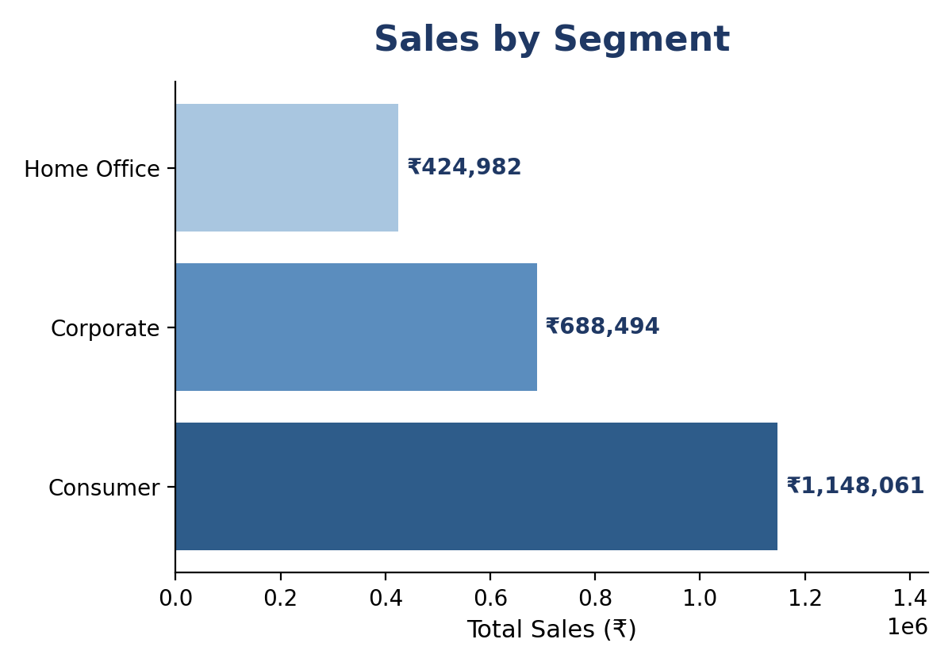
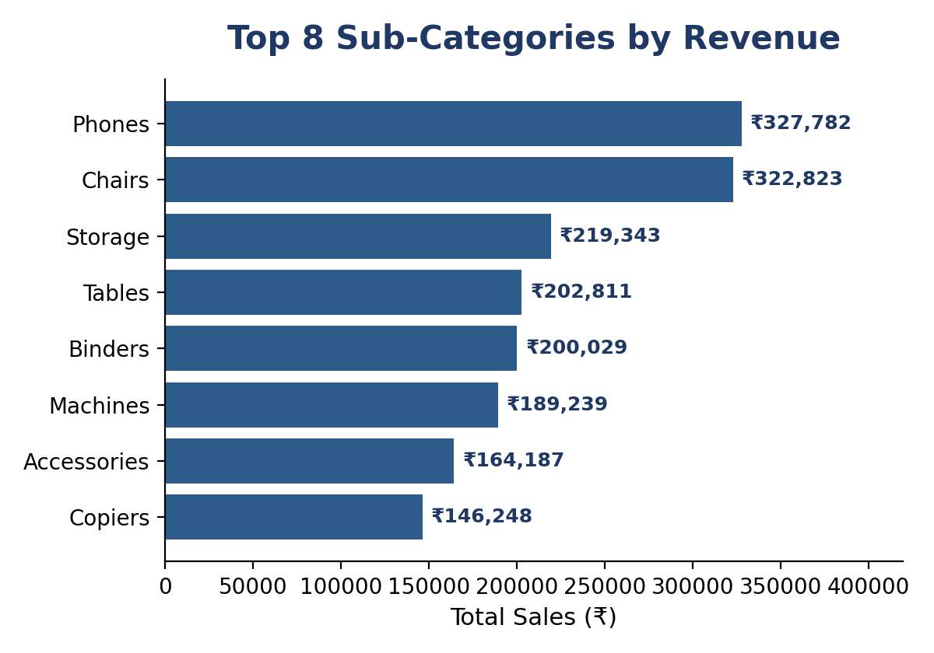
Intermediate Level — Key Charts

Slide 8
SECTION 04
Advanced Level
Employee Attrition Dashboard — Power BI
Task: Build an executive-style, interactive dashboard using Power BI (IBM HR Analytics dataset, 1,470 employees).
Cleaned data via Power Query; removed constant columns (EmployeeCount, Over18, StandardHours).
Built 10+ DAX measures: Attrition Rate, department/segment breakdowns, average income, etc.
Visuals: KPI cards, Attrition Rate gauge, bar/donut/line charts, AI-powered Key Influencers.
Interactive slicers (Department, Gender, OverTime) with full cross-filtering.
AI KEY INFLUENCERS
Age ≤ 21 → 3.57x risk
OverTime = Yes → 2.93x risk
JobRole = Sales Rep → 2.70x risk
Tools: Power BI Desktop • Power Query • DAX
Dataset: Kaggle — IBM HR Analytics Attrition

Slide 9
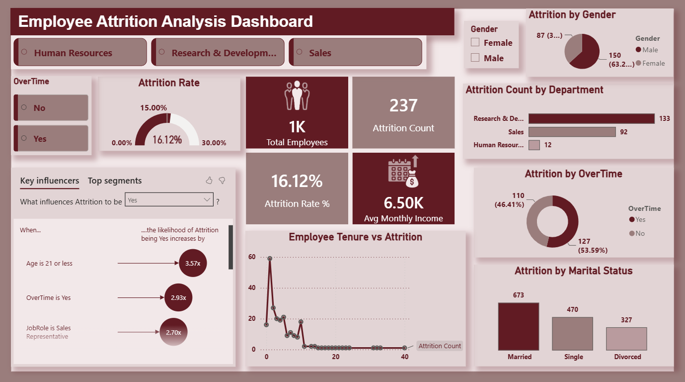
Advanced Level — Final Dashboard

Slide 10
SECTION 05
Conclusion
This internship took me from basic spreadsheet reporting to building a fully interactive, insight-driven Power BI dashboard. Each level built directly on the skills of the one before it — the Beginner level established a foundation in data cleaning and formula-based reporting; the Intermediate level pushed toward deeper business interpretation through customer and segment analysis; and the Advanced level introduced professional BI tooling and AI-assisted insight discovery.
Technical Growth
Business Thinking
Structured Reporting
Excel formulas, Power BI, Power Query, and DAX — hands-on, job-ready tooling.
Learned to ask not just what the data shows, but why it matters and what to do about it.
Practiced turning raw analysis into a clear narrative for real decision-makers.

Slide 11
THANK YOU
Aditya Kumar Sharma | Data Analyst Intern, ShadowFox

